Slide 1
Demand Paging
Every process in the virtual memory contains lots of pages and in some cases, it might not be efficient to swap all the pages for the process at once.
Because it might be possible that the program may need only a certain page for the application to run.
Let us take an example here, suppose there is a 500 MB application and it may need as little as 100MB pages to be swapped, so in this case, there is no need to swap all pages at once.
The demand paging system is somehow similar to the paging system with swapping where processes mainly reside in the main memory(usually in the hard disk).

Slide 2
Thus demand paging is the process that solves the above problem only by swapping the pages on Demand. This is also known as lazy swapper( It never swaps the page into the memory unless it is needed).
Swapper that deals with the individual pages of a process are referred to as Pager.
Demand Paging is a technique in which a page is usually brought into the main memory only when it is needed or demanded by the CPU.
Initially, only those pages are loaded that are required by the process immediately.
Those pages that are never accessed are thus never loaded into the physical memory.
Whenever a page is needed? make a reference to it;
If the reference is invalid then abort it.
If the page is Not-in-memory then bring it to memory.

Slide 3
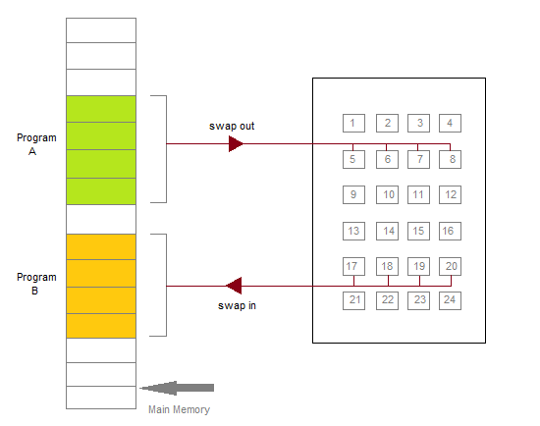
Figure: Transfer of a Paged Memory to the contiguous disk space

Slide 4
Valid-Invalid Bit
Some form of hardware support is used to distinguish between the pages that are in the memory and the pages that are on the disk. Thus for this purpose Valid-Invalid scheme is used:
With each page table entry, a valid-invalid bit is associated( where 1 indicates in the memory and 0 indicates not in the memory)
Initially, the valid-invalid bit is set to 0 for all table entries.
If the bit is set to "valid", then the associated page is both legal and is in memory.
If the bit is set to "invalid" then it indicates that the page is either not valid or the page is valid but is currently not on the disk.

Slide 5
For the pages that are brought into the memory, the page table is set as usual.
But for the pages that are not currently in the memory, the page table is either simply marked as invalid or it contains the address of the page on the disk.
During the translation of address, if the valid-invalid bit in the page table entry is 0 then it leads to page fault.

Slide 6
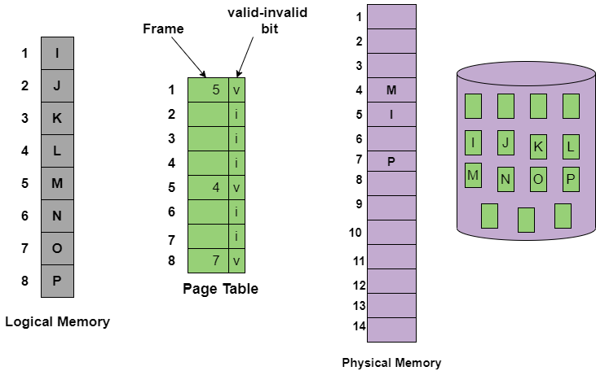
The above figure is to indicates the page table when some pages are not in the main memory.

Slide 7
How Demand Paging Works?
First of all the components that are involved in the Demand paging process are as follows:
Main Memory
CPU
Secondary Memory
Interrupt
Physical Address space
Logical Address space
Operating System
Page Table

Slide 8
When the process requires any of the pages that are not loaded into the memory, a page fault trap is triggered and the following steps are followed,
The memory address which is requested by the process is first checked, to verify the request made by the process.
If it is found to be invalid, the process is terminated.
In case the request by the process is valid, a free frame is located, possibly from a free-frame list, where the required page will be moved.

Slide 9
4.A new operation is scheduled to move the necessary page from the disk to the specified memory location. ( This will usually block the process on an I/O wait, allowing some other process to use the CPU in the meantime. )
5.When the I/O operation is complete, the process's page table is updated with the new frame number, and the invalid bit is changed to valid.
6.The instruction that caused the page fault must now be restarted from the beginning.

Slide 10
Advantages of Demand Paging
The benefits of using the Demand Paging technique are as follows:
With the help of Demand Paging, memory is utilized efficiently.
Demand paging avoids External Fragmentation.
Less Input/Output is needed for Demand Paging.
This process is not constrained by the size of physical memory.
With Demand Paging it becomes easier to share the pages.
With this technique, portions of the process that are never called are never loaded.
No compaction is required in demand Paging.

Slide 11
Disadvantages of Demand paging
There is an increase in overheads due to interrupts and page tables.
Memory access time in demand paging is longer.

Slide 12
Pure Demand Paging
In some cases when initially no pages are loaded into the memory, pages in such cases are only loaded when are demanded by the process by generating page faults. It is then referred to as Pure Demand Paging.
In the case of pure demand paging, there is not even a single page that is loaded into the memory initially. Thus pure demand paging causes the page fault.
When the execution of the process starts with no pages in the memory, then the operating system sets the instruction pointer to the first instruction of the process and that is on a non-memory resident page and then in this case the process immediately faults for the page.

Slide 13
After that when this page is brought into the memory then the process continues its execution, page fault is necessary until every page that it needs is in the memory.
And at this point, it can execute with no more faults.
This scheme is referred to as Pure Demand Paging: means never bring a page into the memory until it is required.

Slide 14
Performance of Demand Paging
Demand paging can significantly affect the performance of a computer system.
To see why, let’s compute the effective access time for a demand-paged memory.
Assume the memory-access time, denoted ma, is 10 nanoseconds.
As long as we have no page faults, the effective access time is equal to the memory access time.
If, however, a page fault occurs, we must first read the relevant page from secondary storage and then access the desired word.
Let p be the probability of a page fault (0 ≤ p ≤ 1). We would expect p to be close to zero— that is, we would expect to have only a few page faults. The effective access time is then
effective access time = (1 − p) × ma + p × page fault time.

Slide 15
To compute the effective access time, we must know how much time is needed to service a page fault. A page fault causes the following sequence to occur:
Trap to the operating system.
Save the registers and process state.
Determine that the interrupt was a page fault.
Check that the page reference was legal, and determine the location of the page in secondary storage.
Issue a read from the storage to a free frame:
Wait in a queue until the read request is serviced.
Wait for the device seek and/or latency time.
Begin the transfer of the page to a free frame.

Slide 16
6.While waiting, allocate the CPU core to some other process.
7.Receive an interrupt from the storage I/O subsystem (I/O completed).
8.Save the registers and process state for the other process (if step 6 is executed).
9.Determine that the interrupt was from the secondary storage device.
10.Correct the page table and other tables to show that the desired page is now in memory.
11.Wait for the CPU core to be allocated to this process again.
12.Restore the registers, process state, and new page table, and then resume the interrupted instruction.

Slide 17
Not all of these steps are necessary in every case. For example, we are assuming that, in step 6, the CPU is allocated to another process while the I/O occurs.
This arrangement allows multiprogramming to maintain CPU utilization but requires additional time to resume the page-fault service routine when the I/O transfer is complete.
In any case, there are three major task components of the page-fault service time:
1. Service the page-fault interrupt.
2. Read in the page.
3. Restart the process.

Slide 18
The first and third tasks can be reduced, with careful coding, to several hundred instructions.
These tasks may take from 1 to 100 microseconds each. Let’s consider the case of HDDs being used as the paging device.
The page switch time will probably be close to 8 milliseconds.
(A typical hard disk has an average latency of 3 milliseconds, a seek of 5 milliseconds, and a transfer time of 0.05 milliseconds.
Thus, the total paging time is about 8 milliseconds, including hardware and software time.) Remember also that we are looking at only the device-service time.
If a queue of processes is waiting for the device, we have to add queuing time as we wait for the paging device to be free to service our request, increasing even more the time to page in

Slide 19
With an average page-fault service time of 8 milliseconds and a memory access time of 200 nanoseconds, the effective access time in nanoseconds is
effective access time = (1 − p) × (200) + p (8 milliseconds)
= (1 − p) × 200 + p × 8,000,000
= 200 + 7,999,800 × p.

Slide 20
We see, then, that the effective access time is directly proportional to the page-fault rate.
If one access out of 1,000 causes a page fault, the effective access time is 8.2 microseconds.
The computer will be slowed down by a factor of 40 because of demand paging!
If we want performance degradation to be less than 10 percent, we need to keep the probability of page faults at the following level:
220 > 200 + 7,999,800 × p,
20 > 7,999,800 × p,
p < 0.0000025

